Slide 1
FHIR for Developers
HL7 Working Group Meeting
Richard Ettema

Slide 2
This presentation
Is licensed for use under the Creative Commons, specifically:
Creative Commons Attribution 3.0 Unported License
(Do with it as you wish, so long as you give credit)

Slide 3
Introduction
Notes:
20 minutes (10:20 end)

Slide 4

Who am I?
Name: Richard Ettema
Company: AEGIS.net, Inc.
Background:
Involved in FHIR almost from the beginning (5+ years)
Sr. Architect of the Touchstone FHIR Testing Platform
Author of the AEGIS WildFHIR Test Server/Client
Member: FHIR-I, Conformance

Slide 5
Introductions
Who are:
Developers, Clinicians, Managers, Academics
Who is familiar with:
v2, v3, CDA
Who has been to the other tutorials
Who went to the FHIR Connectathon
Who has a good basic understanding of FHIR

Slide 6
Level Setting
Should be familiar with basics of FHIR – from Introduction to FHIR or equivalent presentation or experience
This presentation will drill a little deeper into FHIR resources, REST, profiling, messaging, documents, XML and JSON syntax, etc.
We’ll get through as much as we can . . .

Slide 7
Learning Objectives
You will become (more) familiar with:
The four interoperability paradigms supported by FHIR
The FHIR REST service operations and how to implement them
How the XML and JSON wire formats are used in FHIR
FHIR versioning, bundles and contained resources
Strategies for using object models, validation and (de)serialization
Use of relational or document-oriented storage for persistence of resources
FHIR search parameters and their functionality
Notes:
9:15

Slide 8
Contents of this tutorial
Background
Resources
FHIR RESTful service interface
Resources in code
Bundles, Search
Beyond REST
Profiling
Beyond FHIR
Exposing FHIR
Notes:
[RS] This modified to match the actual section (also note here that the brochure Sept 2014 is wrong)
(RS – actual sections below. TODO update this slide.)
Introduction
Deconstructing FHIR
REST Interface
Resources in code
Break
Bundles
Search
Beyond REST
Inside the FHIR distro
Profiles and validation
Building a FHIR server
The End… is near

Slide 9
DSTU/STU/R?
It’s a release/publication status
Draft Standard for Trial Use
Relabelled STU based on industry-wide use
Going forward FHIR versions now labelled simply as ‘R#’; e.g. R3, R4
Previous official version is STU3 (R3)
This presentation is based on R3
Current official version is R4 (first with normative content)
Scope finalized at the beginning of 2018
Published December 2018

Slide 10
FHIR TIMELINE
We are here
First Draft
~ 1st
DSTU
~ 2nd
STU
~ 3rd
STU
~ 1st
Norm.
~ 2nd
Norm.
Fresh
Look
2011
2012
2013
2014
2015
2016
2017
2018
2019
2020

Slide 11
Helpful resources
Notes:
20 minutes (10:20 end)

Slide 12
Development resources
Public Test Servers
Varying capabilities and FHIR version support; e.g.
HAPI (Java)
Vonk (.Net)
Many more…
Invaluable to experiment
Typical features:
Manual interaction
Validation
Core and extended operations
Useful Tools
Modern web browser
REST client
XML/JSON editor
Libraries
RI: Java / .Net / others
Examples, Schemas
Validation

Slide 13
Testing Platforms
Crucible (MITRE) https://www.projectcrucible.org
Supports FHIR DSTU2 and STU3
FHIR Server Testing
Touchstone (AEGIS.net, Inc.) http://touchstone.com
Supports FHIR DSTU2, STU3, R4 and all intermediate or snapshot (Connectathon) versions
FHIR Client and Server Testing

Slide 14
clinFHIR
Designed to support the Clinicians on FHIR events
A suite of educational tools
View resource instances
Build resource
View Profile
Build simple profile
Build simple valueset
http://clinfhir.com

Slide 15
The Community
HL7 FHIR Foundation – http://www.fhir.org
FHIR Chat (Zulip) – https://chat.fhir.org
FHIR Community Forum – http://community.fhir.org
FHIR Listsrv – fhir@lists.hl7.org
FHIR Wiki – http://wiki.hl7.org/index.php?title=FHIR
FHIR gForge Tracker – http://wiki.hl7.org/index.php?title=FHIR_gForge_Tracker
Notes:
Put a query out in real time…

Slide 16
Elevator speech
FHIR is:
About clinical information exchange
“Resources” to represent clinical ‘things’
A well defined API supporting all paradigms
An incredible – international - community
Spreading like <insert pun here>

Slide 17
FHIR resources
Notes:
Time: 10:20-10:50 (30 minutes)

Slide 18

Resources
“Resources”:
are small logically discrete units of exchange
have defined behaviour and meaning
have a known identity / location
is the smallest unit of transaction
is “of interest” to healthcare
V2 comparison: Sort of like Segments
V3 comparison: Sort of like CMETs
Notes:
Go into spec and look at resources (reminder from earlier slide)

Slide 19
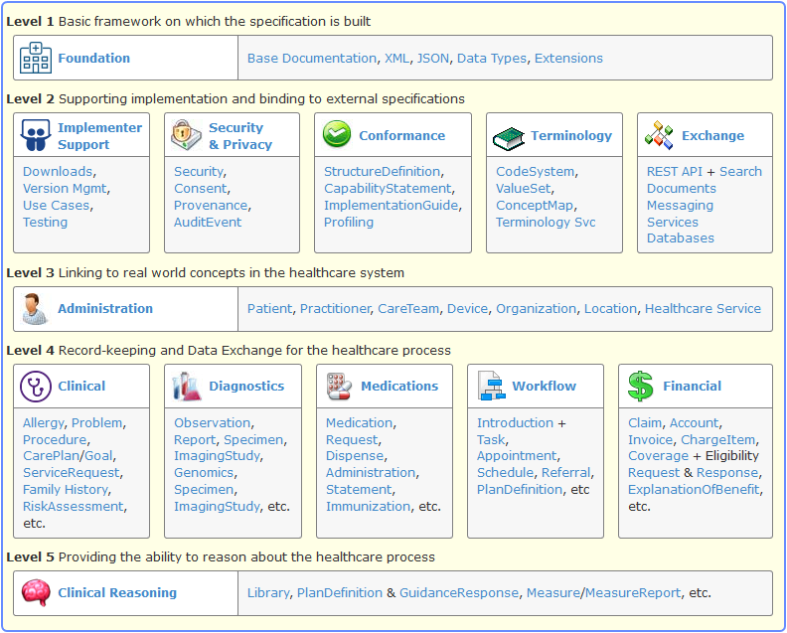
Modules

Slide 20

Structure of a Domain Resource
Metadata
Resource
Narrative
Elements
Extensions
Extensions

Slide 21
<Patient xmlns="http://hl7.org/fhir">
<id value="example"/>
<meta>
<lastUpdated value="2017-01-14T09:14:33Z"/>
</meta>
<text>
<status value="generated"/>
<div xmlns="http://www.w3.org/1999/xhtml">
<p>Henry Levin the 7th</p>
</div>
</text>
<extension url="http://hl7.org/fhir/StructureDefinition/us-core-birthsex">
<valueCode value="M"/>
</extension>
<identifier>
<use value="usual"/>
<system value="urn:oid:1.2.36.146.595.217.0.1"/>
<value value="12345"/>
</identifier>
<active value="true"/>
<name>
<use value="official"/>
<family value="Levin"/>
<given value="Henry"/>
<suffix value="the 7th"/>
</name>
<gender value="male"/>
<birthDate value="1974-12-25"/>
<managingOrganization>
<reference value="Organization/example"/>
</managingOrganization>
</Patient>
FHIR Id & Metadata
Human Readable Summary
Extension with reference to its definition
Standard Data Content:
Patient Identity
Name
Gender
Date of Birth
Provider

Slide 22
Composition versus Reference
FHIR makes composition and references explicit
Contained resources
Composition is within a Resource: Components have no meaning outside resource, no identity, no separate access path except through resource
Referenced resources
References are between Resources. No context conduction across references – safe retrieval as individual resources.
Notes:
No context conduction: if a Condition resource references a particular Patient as it's subject, and it links to a Procedure resource as it's cause, there is no automatic rule or implication that the procedure has the same patient as it's subject.

Slide 23
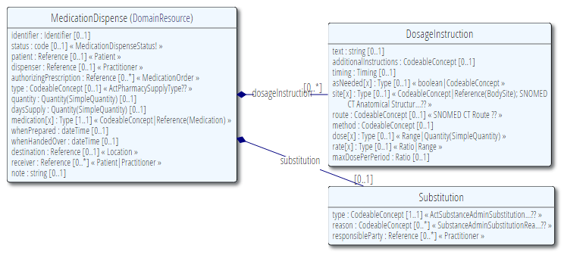
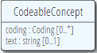
Components of a Resource
Resource Root
Resource Component
Simple & Complex elements (may be repeating)
Notes:
Medication Dispense – the Resource root
Dispense & Substitution are components within Medication Dispense
Use of non-primitive “datatypes” / “value types”
[RS] Black diamond signifies Composition – these don’t have a life outside of the associated class.

Slide 24
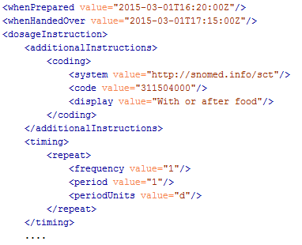
Components of a Resource
Notes:
Go into spec and look at element types – the hierarchy of elements – Domain Resource

Slide 25
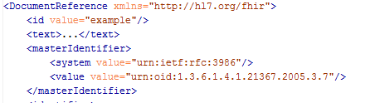
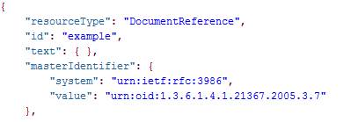
XML & JSON

Slide 26
Resource References
Coded Properties
type
bodySuite
indication
performer.role
complication
relatedItem.type
Other Properties
identifier (Identifier)
outcome (String)
PATIENT
Subject
CONDITION
RelatedItem
PROCEDURE
Report
DIAGNOSTIC REPORT
Encounter
Performer
ENCOUNTER
PRACTITIONER

Slide 27
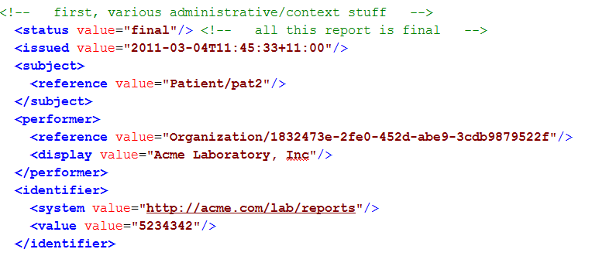
Resource References
Example: part of DiagnosticReport
Notes:
References between resources are not by “business key”, it is *not* the patient id, it’s a REST URI! [RS]

Slide 28
Recording a consultation
12-year-old-boy
First consultation
Complaining of pain in the right ear for 3 days with an elevated temperature. On examination, temperature 38°C and an inflamed right eardrum with no perforation. Diagnosis Otitis Media, and prescribed Amoxicillin 250mg 3 times per day for 7 days.
Follow up consultation
2 days later returned with an itchy skin rash. No breathing difficulties. On examination, urticarial rash on both arms. No evidence meningitis. Diagnosis of penicillin allergy. Antibiotics changes to Erythromycin 250mg 4 times per day for 10 days.
Patient
Encounter
Condition
Observation
Medication
Allergy Intolerance

Slide 29
Pain right ear 3 days
Asserter
Patient
Encounter
Elevated temperature
Performer
Temperature 38°C
Performer
Practitioner
Inflamed right drum
Performer
Otitis media
Asserter
Amoxicillin 250mg
Prescriber
Itchy skin rash
Asserter
Encounter
No breathing difficulties
Asserter
Urticarial Rash
Performer
Penicillin Allergy
Performer
Erythromycin 250mg
Performer

Slide 30
clinFHIR Demo
Public HAPI STU3
Public AEGIS WildFHIR STU3

Slide 31
A Resource’s identity
In fact: a URL
http://server.org/fhir/Patient/1
resource type
endpoint
id
Note: This URL resolves to the current version of a resource
Notes:
This is not only the URL you use to retrieve the resource, it’s also its id.
All URL’s in FHIR are case-sensitive (and so is the id)
It is *metadata*, you won’t find this in the Resource’s definition

Slide 32
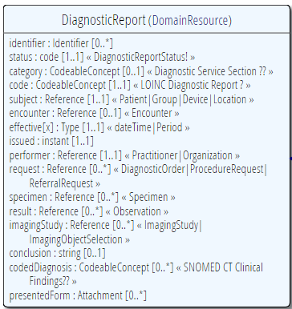
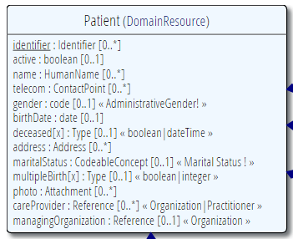
“Business” identifiers
Notes:
Resource Id’s (=URLs) are infrastructural id’s, they differ from “business” identifier.
Many Resources also have business identifiers, they are explicitly modeled, like Patient.identifier (even more than one identifier possible!)
Business identifiers are completely separate from technical resource id’s
The URL is the position of the resource and isn’t shown in the resource itself (metadata, see next slide) [RS]
Good to use words “Id” or “identifier” (even though those words are actually the same thing in most other contexts) [RS]

Slide 33
Resource Metadata
Metadata
Patient
MRN 22234
“Ewout Kramer”
30-11-1972
Amsterdam
<id value="4705149-patient"/> <meta> <versionId value="4"/> <lastUpdated value="2016-08-10T16:18:46Z"/>
<profile value=… />
<security value=…/>
<tag value= …/> </meta>
…
Notes:
Pink box is resource
Metadata has the ID, and history with version of 4
(core resource and stuff around the resource – yellow is no longer in HTTP, but in metadata) - http://hl7.org/fhir/taghttp://example.org/fhir/Status#Test
In Bundle there are eTAGS

Slide 34
Metadata Tags
Contains metadata about resources
Beyond ID: version & date
Used for different purposes:
<profile> → Compliance to one or more profiles
<security> → Security – e.g. sensitivity of the resource data
<tag> → User defined – e.g. test data
Transported in different ways:
REST – as an HTTP header
In a Bundle (document, message, transaction)
In the metadata element of the resource or the Bundle

Slide 35
The FHIR Elements
Complex
Datatypes (HumanName, Quantity, Period, Address, Identifier )
Constrained Types (Quantity: Distance, Count, Duration, Money)
Metadata
Resource
Narrative
use
Elements
use
Extensions
Extensions
Primitives (integer, boolean,
string, instant)
use
Derived Primitives
(oid, uuid, code, id)
Notes:
[RS] changed composite to complex
[RS – resources are user definable?] Only the Resources are user-definable, other types are “built-in”
Derived primitives are patterns -> validation consists of regexp matching
Constrained types are defined using invariants (OCL, Xpath, prose) -> validation using schematron, code
[RS] Narrative and Extension are both ONLY used in Resources
Resources can use both (derived) primitives and complex composite datatypes in its definitions
[RS] Infrastructural types need special handling, not general-purpose types

Slide 36
Datatypes
Read more at:
http://www.hl7.org/implement/standards/fhir/datatypes.html
Notes:
Datatypes use both primitives and other datatypes.
Some datatypes use attributes with cardinality > 1
CodeableConcept.primary is actually refers to a coding in CodeableConcept.coding, so is not a code itself.
Quantity has constrained variations Distance, Count, Duration, Money. They introduce constraints on useable units, but do not add attributes, so not shown here.
Note that HumanId.assigner refers to a Resource

Slide 37
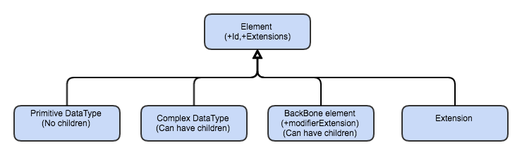
Element Hierarchy

Slide 38
Primitive data types
instant
time
date
dateTime
decimal
Element
boolean
integer
base64Binary
string
url
code
id
oid
unsignedInt
postiveInt
markdown

Slide 39
Details of some
boolean | xs:boolean | Values can be either true or false
integer | xs:int | A signed 32-bit integer
decimal | xs:decimal | A rational number. A true decimal, with inbuilt precision (e.g. Java BigDecimal)
base64Binary | xs:base64Binary | A stream of bytes, base64 encoded
instant | xs:dateTime | An instant in time - known at least to the second and always includes a timezone.
string | xs:string | A sequence of Unicode characters.
uri | xs:anyURI | A Uniform Resource Identifier Reference.
date | union of xs:date, xs:gYearMonth, xs:gYear | A date, or partial date as used in human communication. No time zone.
id | xs:string | Any combination of upper or lower case ASCII letters ('A'..'Z', and 'a'..'z', numerals ('0'..'9'), '-' and '.', with a length limit of 64 characters. regex: [A-Za-z0-9\-\.]{1,64}
Notes:
Now we will look at FHIR definitions from the bottom up, from datatype primitives, in several steps up to resources [RS]
The lexical rendering for these primitives in Xml is the same as in JSON (maybe this should go in the serialization section)
Expressing the allowed values in terms of XSD primitives brings in more variability then we would like. E.g. “0” and “1” are valid for xs:boolean. “+000004”, “4”, “+4” are all valid decimals.

Slide 40
Complex data types
Ratio
Period
Range
Attachment
Identifier
Timing
HumanName
Coding
Element
Annotation
Signature
Address
CodeableConcept
Quantity
SampledData
ContactPoint
Age
Distance
SimpleQuantity
Duration
Count
Money

Slide 41
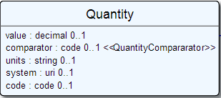
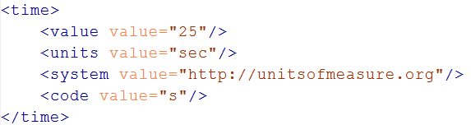
Example
Notes:
The content of a primitive is not rendered in XML as a text node but as an attribute
Notice how the “system” of a code is now a uri, so unlike in v3 an OID is now ALSO a uri (urn:oid:1.2.3.4.5)

Slide 42
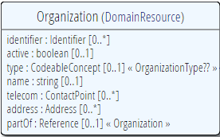
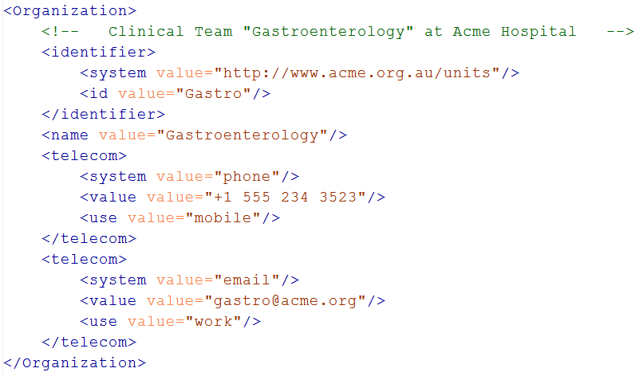
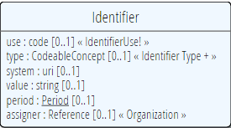
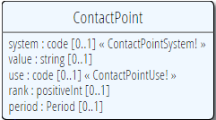
Resources
Notes:
The element “identifier” is of type Identifier
The element “telecom” repeats, there is no notion of a “list” in Xml.
Empty elements are left out
Rik – Both Identifier and Contact are datatypes, of identifier and telecom respectively
Rik – somewhat confusing that Organization.telecom has a type of Contact, and there is also a component class in Organization called Contact.

Slide 43
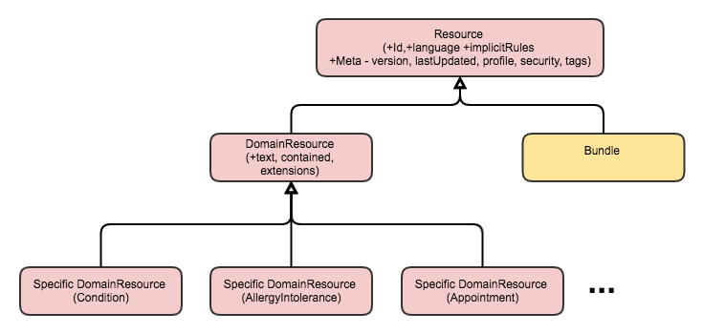
Resource Hierarchy
View in spec

Slide 44
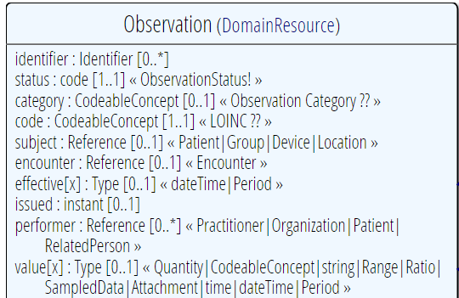
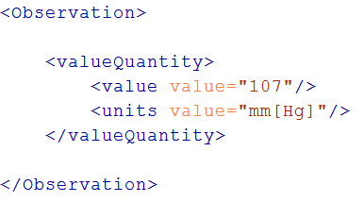
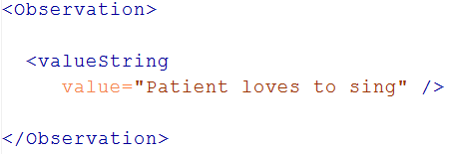
“Choice” properties
Notes:
* value[x] means: An element with a name that starts with “value”. The [x] is replaced by the (capitalized) name of the actual datatype

Slide 45
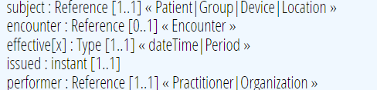
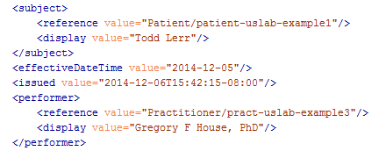
References
Notes:
There are references that can reference more than one type of resource! In this example: Resource(Patient | Group | Device)
The reference has a “type” element to indicate the kind of Resource that is referenced
References may be: Relative (on the same server), absolute URL (somewhere external) and internal (not treated here)

Slide 46
Quick look at narrative
Metadata
Resource
Narrative
Elements
Extensions
Extensions

Slide 47
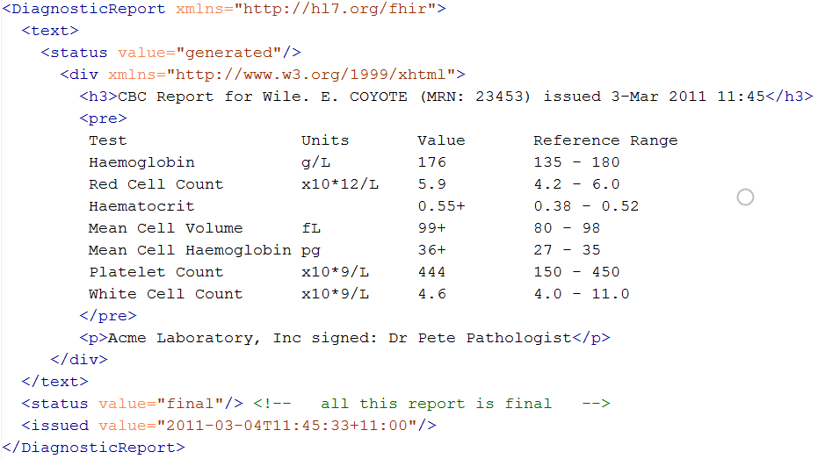
Narrative
Notes:
Resources SHOULD always contain narrative to support human-consumption as a fallback. However, in a strictly managed trading systems where all systems share a common data model and additional text is unnecessary or even a clinical safety risk, the narrative may be omitted.

Slide 48
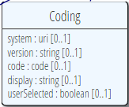
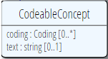
Coded types
code
Codes are defined in code systems
Notes:
CodeableConcept builds on Coding, which uses code [RS]
[Rik - This slide redone, CodeableConcept had extra attribute, also swapped the classes around. XML was using Problem which no longer exists]
Examples is from http://www.hl7.org/implement/standards/fhir/observation.htm
[RS] [removed bindings part, next slide]

Slide 49
Examples
Code: "status" : "confirmed"
Coding: { "system": "http://www.nlm.nih.gov/research/umls/rxnorm", "code": "C3214954", "display": "cashew nut allergenic extract Injectable" }
CodeableConcept: { "coding": [{ "system": "http://snomed.info/sct", "code": "39579001", "display": "Anaphylactic reaction“ }], "text" : "Anaphylaxis" }

Slide 50
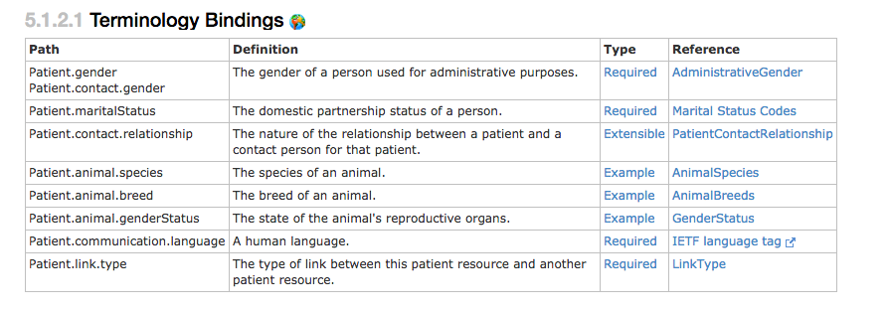
Coded types
When used in a Resource, the modelers include Bindings
Bindings specify which codes can be used
Notes:
Rik - Bindings are to value sets, as indicated by the “/vs/” in that path.

Slide 51
Binding Strength
How closely the options in the value set should be followed
Values
Required (MUST come from set)
Extensible (MAY use alternate if have to)
Preferred (don’t have to, but SHOULD)
Example (set isn’t specified)
Can vary in Profile
(Make stronger not weaker)

Slide 52
ValueSet resource
Defines list of possible values for a particular context
Can reference external Terminology/s
Or define own sets
Why?
A common ValueSet improves recording consistency
Improves user experience (pick lists)
Examples in New Zealand
ED diagnoses (derived from SNOMED)
NZ POCS (Pathology Observation Code Set) (derived from LOINC)
List of NZ Maori Tribes or “Iwi” (defined in ValueSet)

Slide 53
Terminology Sub-system
Code System:
Defines a set of concepts with a coherent meaning Code Display
Definition
SNOMED CT / LOINC / RxNORM
HGVS, ICPC, MIMS + 100s more
ICD-X+
ANZSCO, METEOR
A drug formulary
A config table in an application
A list of enums in a java class
Australian state codes

Slide 54
Terminology Sub-system
Code System:
Defines a set of concepts with a coherent meaning Code Display
Definition
Value Set:
A selection of a set of codes for use in a particular context
Selects
Notes:
Eg condition with different specialties

Slide 55
Terminology Sub-system
Code System:
Defines a set of concepts with a coherent meaning Code Display
Definition
Value Set:
A selection of a set of codes for use in a particular context
Element Definition: Type and Value set reference
Binds
Selects

Slide 56
Terminology Sub-system
Code System:
Defines a set of concepts with a coherent meaning Code Display
Definition
Value Set:
A selection of a set of codes for use in a particular context
Element Definition: Type and Value set reference
Binds
Selects
Conforms
Element: code/ Coding/ CodeableConcept
Refers to

Slide 57
ValueSet for condition.code
{
"resourceType": "ValueSet",
"id": "condition-code",
"meta": {
"lastUpdated": "2017-04-19T07:44:43.294+10:00",
"profile": [
"http://hl7.org/fhir/StructureDefinition/shareablevalueset"
]
},
"text": {
"status": "generated",
"div": "<div>!-- Snipped for Brevity --></div>"
},
"url": "http://hl7.org/fhir/ValueSet/condition-code",
"identifier": [
{
"system": "urn:ietf:rfc:3986",
"value": "urn:oid:2.16.840.1.113883.4.642.3.152"
}
],
"version": "3.0.1",
"name": "Condition/Problem/Diagnosis Codes",
"status": "draft",
"experimental": true,
"date": "2017-04-19T07:44:43+10:00",
"publisher": "FHIR Project team",
…
"description": "Example value set for Condition/Problem/Diagnosis codes",
"copyright": "This value set includes content from SNOMED CT, which is copyright © 2002+ International Health Terminology Standards Development Organisation (IHTSDO), and distributed by agreement between IHTSDO and HL7. Implementer use of SNOMED CT is not covered by this agreement.",
"compose": {
"include": [
{
"system": "http://snomed.info/sct",
"filter": [
{
"property": "concept",
"op": "is-a",
"value": "404684003"
}
]
},
{
"system": "http://snomed.info/sct",
"concept": [
{
"code": "160245001",
"display": "No current problems or disability"
}
]
}
]
}
}

Slide 58




Terminology Server
Provides ‘services’ for consumers to access terminology
Hide the complex stuff from a consumer
Uses Operations framework
Get definition for a concept
Find a concept
Within a ValueSet
Validate a code
Find Terms
Get Term Definition
http://hl7.org/fhir/terminology-service.html
Notes:
Expand
http://fhir-dev.healthintersections.com.au/open/ValueSet/valueset-condition-code/$expand?filter=diabetes
Lookup
http://fhir-dev.healthintersections.com.au/open/ValueSet/$lookup?system=http://loinc.org&code=8480-6

Slide 59
REST service interface
How FHIR uses RESTful principles to communicate Resources
Notes:
Time: 10:50 – 11:30

Slide 60
REST Paradigm
FHIR supports 4 interoperability paradigms
REST
Documents
Messages
Services

Slide 61
REST?
“REpresentational State Transfer”
Represent your data as “resources”
Make “Resources” URI addressable
Use HTTP to do CRUD operations
Resources may be exchanged using different representations

Slide 62
Can be distributed…
FHIR server @ pat.registry.org
FHIR server @ lab.hospitalA.org
Patient/223
DiagnosticReport/4445
Observation/3ff27
Patient
subject
Observation
Diagnostic
Report
result
managing
performer
FHIR server @ hospitalA.org
Organization/1
Practitioner/87
Organization
Practitioner
Notes:
Rik – Start at the top right with the report

Slide 63
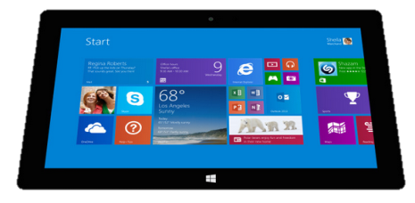

“Repository” model of healthcare
Hospital System
Lab System
Create
Update
Create
Update
Create
Update
Query
Query
Subscribe
FHIR server
Patient
Diagnostic
Report
Observation
Patient
Observation
Organization
Patient
Observation

Slide 64
Just a quick GET
GET /fhir/Patient/1 HTTP/1.1
HTTP/1.1 200 OK
Content-Type: application/xml+fhir;charset=utf-8
Content-Length: 787
Last-Modified: Tue, 29 May 2012 23:45:32 GMT
HTTP Verb + path
<?xml version="1.0" encoding="UTF-8"?>
<Patient xmlns="http://hl7.org/fhir"><identifier><label>SSN</label><identifier><system>
http://hl7.org/fhir/sid/usssn</system><id>444222222</id></identifier></identifier><name><use>official</use><family>Everywoman</family><given>Eve</given></name><telecom><system>phone</system><value>555-555 2003</value><use>work</use></telecom><gender><system>http://hl7.org/fhir/sid/v2-0001</system>
<code>F</code></gender><birthDate>1973-05-31</birthDate><address><use>home</use><line>2222 Home Street</line></address><text><status>generated</status><div xmlns="http://www.w3.org/1999/xhtml">Everywoman, Eve. SSN:444222222</div></text></Patient>
UTF-8 encoded
Version in resource
Notes:
You can retrieve any person using a GET on the person’s id, which is just an url on the server: /fhir/Patient/<id>
We have our own MIME-type: “text/xml+fhir”
Note that FHIR always uses UTF-8. Since this is not the default for HTTP, the server explicitly mentions this
But should mean the xml encoding mentions “utf-8” and that the payload is really encoded in utf-8
There can be a Byte Order Mark, but hopefully your framework handles all that ;-) [RS this is an optional character string preceding a UTF-8 set of bytes, to say if little endian or big endian – which is actually irrelevant to UTF-8]
The response returns a Content-Location header with a version-specific location….see next slide 52 [RS]
Specify XML / JSON
More on query later

Slide 65
A Resource’s REST identity
In fact: a URL
http://server.org/fhir/Patient/1
resource type
endpoint
id
Note: This URL resolves to the current version of a resource
Notes:
This is not only the URL you use to retrieve the resource, it’s also its id.
All URL’s in FHIR are case-sensitive (and so is the id)
It is *metadata*, you won’t find this in the Resource’s definition

Slide 66
Resource metadata
Metadata
Patient
MRN 22234
“Ewout Kramer”
30-11-1972
Amsterdam
<id value="4705149-patient"/> <meta> <versionId value="4"/> <lastUpdated value="2016-08-10T16:18:46Z"/>
<version value=“http://… /> <security value=…/>
<tag value= …/>
</meta>
…
Notes:
Pink box is resource
Metadata has the ID, and history with version of 4
(core resource and stuff around the resource – yellow is no longer in HTTP, but in metadata) - http://hl7.org/fhir/taghttp://example.org/fhir/Status#Test

Slide 67
Mapping (meta) data to HTTP
Meta data
Resource data
Resource id
Resource version
Last update date
HTTP
Body or payload
Url path
Url path or ETag header
Last-Modified header
Notes:
Note that the Version Id is considered a "weak" ETag and ETag headers should be prefixed with W/ and enclosed in quotes, for example: ETag: W/"3141"

Slide 68
Let’s look at the header
PUT http://fhir.furore.com/fhir/Patient HTTP/1.1
Body [Patient resource]
HTTP/1.1 200 OK
Content-Type: application/xml+fhir;charset=utf-8
Content-Length: 787
ETag: w/”12”
Location: http://fhir.furore.com/fhir/Patient/1/_history/12
Last-Modified: Tue, 29 May 2012 23:45:32 GMT
Body [Patient or OperationOutcome]
Notes:
You can retrieve any person using a GET on the person’s id, which is just an url on the server: /fhir/person/@<id>
We have our own MIME-type: “text/xml+fhir”
Note that FHIR always uses UTF-8. Since this is not the default for HTTP, the server explicitly mentions this
But should mean the xml encoding mentions “utf-8” and that the payload is really encoded in utf-8
There can be a Byte Order Mark, but hopefully your framework handles all that ;-)
The response returns a Content-Location header with a version-specific location….see next slide

Slide 69
For a specific version…
We have the version-specific URL
http://server.org/fhir/Patient/1/_history/4
base path
resource type
identifier
version id
Notes:
Both the Resource id URL and the version-specific URL are used on many places of the REST spec and resource content (References!). They are always used consistently in this form.

Slide 70
REST “representations”
GET /fhir/Patient/1?_format=json HTTP/1.1
HTTP/1.1 200 OK
Content-Type: application/json+fhir;charset=utf-8
Content-Length: 787
GET /fhir/Patient/1 HTTP/1.1
Accept: application/json+fhir
HTTP/1.1 200 OK
Content-Type: application/json+fhir;charset=utf-8
Content-Length: 787
Notes:
You can retrieve any patient using a GET on the patient’s id, which is just an url on the server: /fhir/Patient/<id>
We have our own MIME-type: “application/xml+fhir” and “application/json+fhir”

Slide 71
Mapping to verbs
create 3.1.0.8
The create interaction creates a new resource in a server assigned location. The create interaction is performed by an HTTP POST operation as shown:
POST [service-url]/[resourcetype] (?_format=mimeType)
read 3.1.0.2
The read interaction accesses the current contents of a resource. The interaction is performed by an HTTP GET operation as shown:
GET [service-url]/[resourcetype]/{id} (?_format=mimeType)
update 3.1.0.4
The update interaction creates a new current version for an existing resource or creates a new resource if no resource already exists for the given id. The update interaction is performed by an HTTP PUT operation as shown:
PUT [service-url]/[resourcetype]/{id} (?_format=mimeType)
delete 3.1.0.7
The delete interaction removes an existing resource. The interaction is performed by an HTTP DELETE operation as shown:
DELETE [service-url]/[resourcetype]/{id}
Notes:
Rik – these are section numbers from FHIR spec

Slide 72
To create a resource
You POST the contents to an URL which indicates the resource type:
E.g. http://server.org/fhir/Patient
Supply body’s format in Content-Type header
Server returns 201 (Created).
Returns the newly assigned version id URL in the Location header.

Slide 73
To update a resource
Use PUT on the resource’s URL, with the new contents in the body
Tell server the body’s format (xml/json) in the Content-Type header
Server returns 200 and the URL to new version in the Location header.

Slide 74
Using PUT to create
Server may or may not allow you to PUT to an id that does not yet exist.
If it does: Server returns 201 and resource gets created at that location ➔ client determines resource’s id!
If it does not: server returns 405 (Method not allowed)
Notes:
- Whether server allows this depends on the level of trust between server and client: e.g. in-house scenario versus nation-wide network.

Slide 75
Version-aware updates
Use ETag & ‘if-match’ header
Server requires client to send ‘if-match’ header with current ETag
Server uses this to check whether you are updating the latest version.
Server will then return 409 (Conflict) if it has been updated by someone else in the meantime
http://hl7.org/fhir/http.html#versionaware
Notes:
Behaviour depends on server configuration (and made public in a conformance statement).

Slide 76
Conditional operations
Create if does not exist
Search query defined in ‘if-none-exist’ header
http://hl7.org/fhir/http.html#ccreate
Update if single match found
Search query defined in URL path parameters
http://hl7.org/fhir/http.html#cond-update
Delete if one or more matches found
Search query defined in URL path parameters
http://hl7.org/fhir/http.html#3.1.0.7.1
Especially useful in transactions and messages

Slide 77
What’s a ‘deleted’ Resource?
HTTP DELETE method
Reading a deleted resource will return a 410 (Gone) result instead of 404 (Not Found)
The resource will not be returned by the search operation
You can “undelete” by doing an update with fresh content
Just a “marker” / version in a resource’s history
Notes:
* the deletion operation should be understood as deleting the record of the resource, with nothing about the state of the real-world corresponding resource implied.

Slide 78
Version history - deletions
33, v12 – 2018-12-04
/server.org/fhir/Patient/33/_history/12
33, v13 – 2018-12-05
/server.org/fhir/Patient/33/_history/13
33, v14 – 2018-12-08
/server.org/fhir/Patient/33/_history/14
33, v15 – 2018-12-09
/server.org/fhir/Patient/33/_history/15
33, v16 – 2018-12-10
DELETION
/server.org/fhir/Patient/33/_history/16
/server.org/fhir/Patient/33
Notes:
* Now, if you query for /server.org/fhir/patient/33, you get a 410 [RS corrected note from @33, no longer using @]

Slide 79
Version history - revival
33, v13 – 2018-12-05
/server.org/fhir/Patient/33/_history/13
33, v14 – 2018-12-08
/server.org/fhir/Patient/33/_history/14
33, v15 – 2018-12-09
/server.org/fhir/Patient/33/_history/15
33, v16 – 2018-12-10
/server.org/fhir/Patient/33/_history/16
33, v17 – 2018-12-11
/server.org/fhir/Patient/33/_history/17
/server.org/fhir/Patient/33
Notes:
* The resource returns back to life!

Slide 80
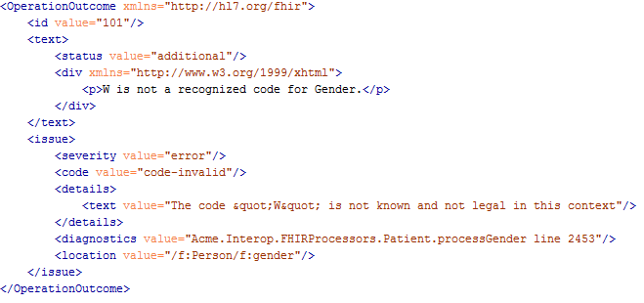
Operation Outcome
When something goes wrong….return the OperationOutcome Resource!

Slide 81
Lists of things
Current Allergies, Medications, Conditions
Use the List resource
Can query through _list
http://hl7.org/fhir/lifecycle.html#current
GET [base]/AllergyIntolerance?patient=42&_list=$current-allergies

Slide 82
The Binary Endpoint
Accepts any kind of content
Stores the content as is, along with the content type provided by the HTTP headers.
Acts just like the normal Resource endpoints (but search is limited)
http://server.org/fhir/Binary/

Slide 83
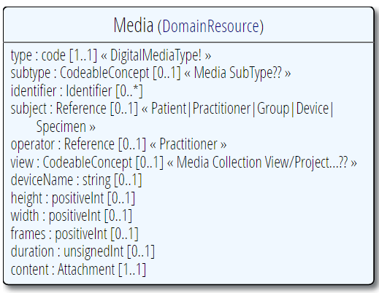
Useful for Attachments
/Binary/23344

Slide 84
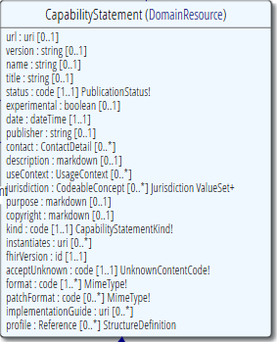
CapabilityStatement
Which FHIR version?
Which Resources?
What search operations?
What formats?
Is this a test server?
Who can I contact?
What’s the name of the software?
DO YOU SUPPORT HISTORY?
DO YOU SUPPORT XML/JSON?
http://hl7.org/fhir/capabilitystatement.html

Slide 85
Resources in code
How resources are made into classes in the supplied reference implementations
Notes:
After break: 12:00-12:10

Slide 86
Reference Implementations
Contents
Model – classes generated from the spec
Parsers – Parsers generated from the spec
Serializers – Serializers generated from the spec
FhirClient
Validation (currently Java only)
Java – Everything on the downloads page
HAPI library - http://hapifhir.io
.NET – NuGet “FHIR”, or GitHub “fhir-net-api”
Notes:
[RS]
NuGet syntax: Install-Package Hl7.Fhir –Pre
http://ewoutkramer.github.io/fhir-net-api/whats-new.html

Slide 87
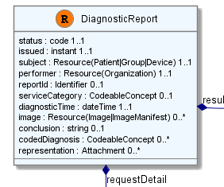
Object Model
[FhirResource("DiagnosticReport")]
public partial class DiagnosticReport : Resource
{
public Code<ObservationStatus> Status {…}
public Instant Issued {…}
public ResourceReference Subject {…}
public ResourceReference Performer {…}
public Identifier ReportId {… }
public
List<DiagnosticReportRequestDetailComponent> RequestDetail { …}

Slide 88
Parsing/Serializing using C#
// Create a file-based reader for Xml
XmlReader xr = XmlReader.Create(new StreamReader(@"publish\observation-example.xml"));
// Parse the Observation from the stream
var obs = (Observation)FhirParser.ParseResource(xr);
// Modify some fields of the observation
obs.Status = Observation.ObservationStatus.Amended;
obs.Value = new Quantity() { Value = 40, Units = "g" };
// Serialize the in-memory observation to Json
var jsonText = FhirSerializer.SerializeResourceToJson(obs);

Slide 89
Parsing/Serializing using Java
XmlParser xml = new XmlParser();
Observation obs = (Observation)xml.parse(new FileInputStream("observation.xml"));
obs.setStatusSimple(ObservationStatus.amended);
Quantity newValue = new Quantity();
newValue.setValueSimple(new BigDecimal(40));
newValue.setUnitsSimple("g");
obs.setValue( newValue );
ByteArrayOutputStream bos = new ByteArrayOutputStream();
JsonComposer comp = new JsonComposer();
comp.compose(bos, obs, true);
String json = bos.toString("UTF8");

Slide 90
Using FHIR Client in C#
var client = new FhirClient(new Uri("http://fhir.com/svc/fhir"));
var patEntry = client.Read<Patient>("1");
var pat = patEntry.Resource;
var restId = patEntry.Id;
var tags = patEntry.Tags;
pat.Name.Add(HumanName.ForFamily("Kramer").WithGiven("Ewout"));
client.Update<Patient>(patEntry);

Slide 91
Using FHIR Client in Java (HAPI)
FhirContext ctx = FhirContext.forDstu3();
String serverBase = "http://fhirtest.uhn.ca/baseDstu3";
IGenericClient client = ctx.newRestfulGenericClient(serverBase);
// Perform a search
Bundle results = client.search()
.forResource(Patient.class)
.where(Patient.FAMILY.matches().value("duck"))
.returnBundle(ca.uhn.fhir.model.dstu3.resource.Bundle.class)
.execute();
System.out.println("Found " + results.getEntry().size() + " patients named 'duck'");
http://jamesagnew.github.io/hapi-fhir/doc_rest_client.html

Slide 92
BUNDLES
Notes:
12:10-12:20

Slide 93
Communicating lists or collections
We communicate lists or collections of resources with the Bundle resource
Search result
History
Documents or messages
Multiple-resource operations (batches or transactions)
Descends from Resource (not DomainResource)
No text, extensions, contained

Slide 94
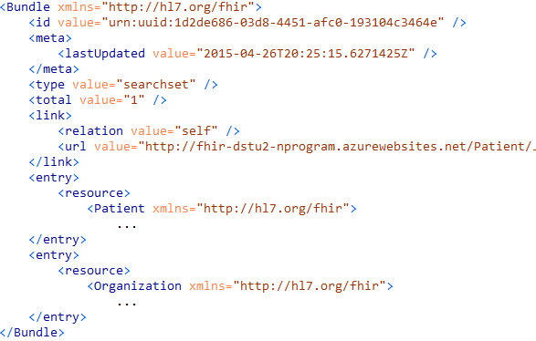
Search query response

Slide 95
Example: Keeping in sync
History of all resources on server
http://server.org/fhir/_history
History of all patient resources on server
http://server.org/fhir/Patient/_history
History of specific patient on server
http://server.org/fhir/Patient/1/_history
A history of all changes: updates and deletions, ordered by newest first
Limit with _since and _count
Notes:
[RS _since is used with _history]

Slide 96
Transactions / Batches
Multiple operations at once
Transaction
Related resources - Referential integrity
Batch
Unrelated
Return bundle with outcomes

Slide 97
Bundles in a Library
C# hides the processing of bundle
Bundle result = new Bundle() { Title = "Demo bundle" };
result.Entries.Add(new ResourceEntry<Patient>()
{ LastUpdated=DateTimeOffset.Now, Content = new Patient() });
result.Entries.Add(new DeletedEntry()
{ Id = new Uri("http://..."), When = DateTime.Now });
var bundleXml = FhirSerializer.SerializeBundleToXml(result);

Slide 98
SEARCH FUNCTIONALITY
And finally, the last REST operation (for now):
Notes:
12:20-12:40

Slide 99
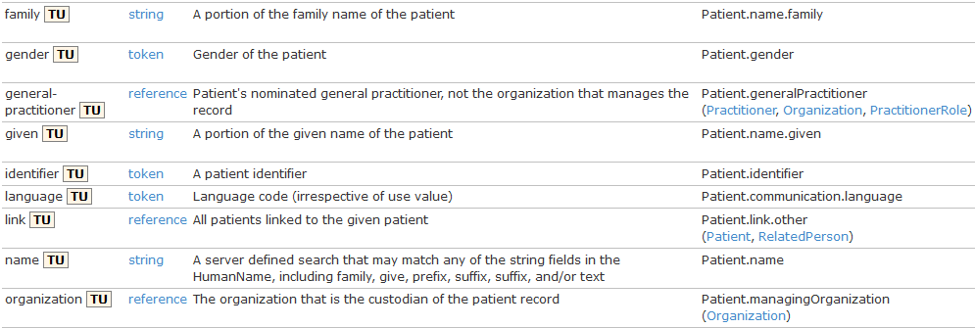
Search (Patient)
Each resource has a set of “standard” search operations, so not every element can be searched!:

Slide 100
Search Parameters
HTTP GET – URL parameters only
HTTP POST – HTML form + URL parameters
Always returns a Bundle
Multiple parameters
Specifying multiple parameters finds resources matching all params ➔ “AND”
http://fhirtest.uhn.ca/baseDstu3/Patient?name=jones&gender=female
Parameters may list multiple values ➔ “OR”
http://fhirtest.uhn.ca/baseDstu3/Patient?name=patel,jones

Slide 101
Ok I get it…or not?
http://server.org/fhir/Patient/ 406 hits
http://server.org/fhir/Patient?gender=M 234 hits
http://server.org/fhir/Patient?gender=F 167 hits
Total: 234 + 167 = 401
http://server.org/fhir/Patient/ 406 hits
http://server.org/fhir/Patient?gender=M 234 hits
http://server.org/fhir/Patient?gender=F 167 hits
http://server.org/fhir/Patient?gender:missing=true 5 hits
Total: 234 + 167 + 5 = 406
Notes:
[RS] key here is that some are neither M nor F
[RS] Look at For more info see modifiers on the HL7 FHIR site (:exact, :missing, etc.) Search, 2.2.2.1

Slide 102
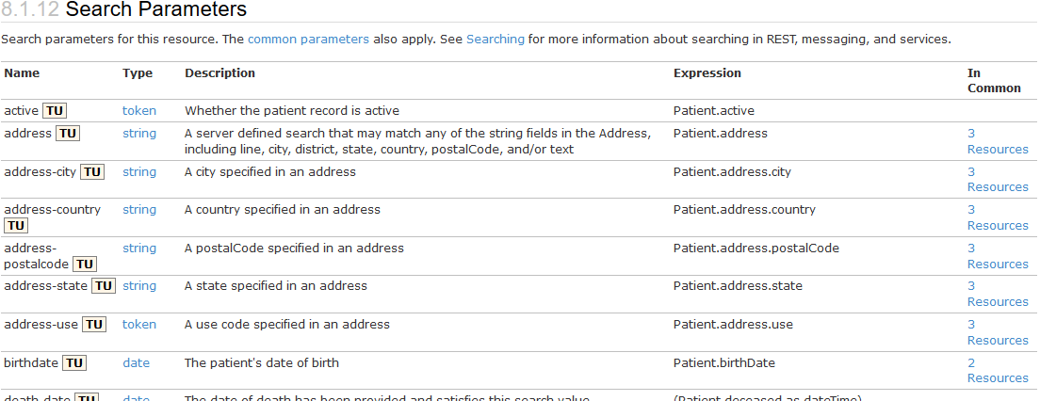
Search Parameters
Listed at the bottom of every resource type definition page
http://hl7.org/fhir/patient.html#search

Slide 103
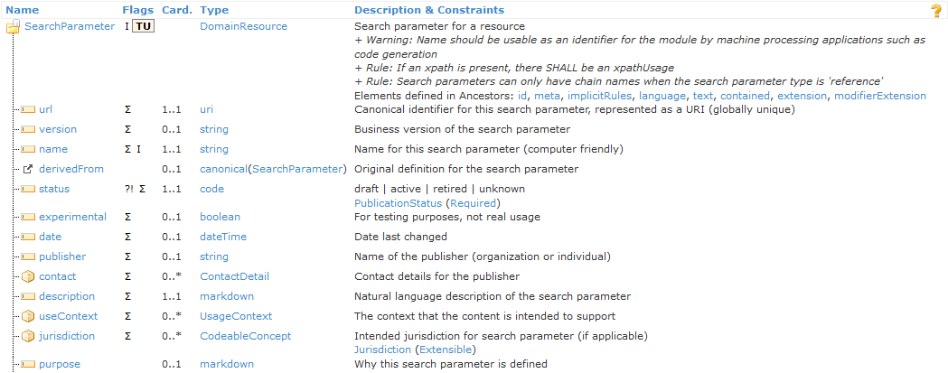
SearchParameter resource type
http://hl7.org/fhir/searchparameter.html#resource

Slide 104
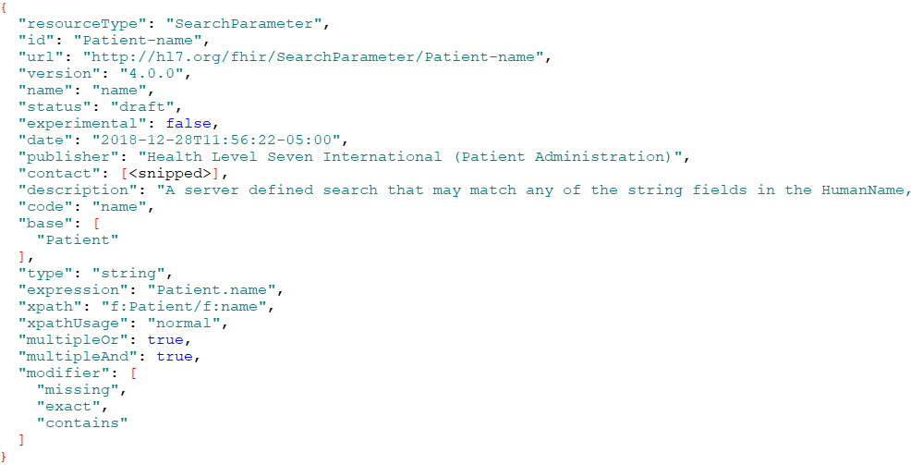
SearchParameter example

Slide 105
Search (Patient)
Each search parameter has a ‘type’
Parameter
Type

Slide 106
Chained searches
Patient has a search for “name”.
Observation has a search for “subject” (the id of the Patient, Group or Device)
How do I find/search Observations for a patient using the Patient’s name?

Slide 107
2 queries in 1
You (as a client) don’t need to do separate operations, just one:
http://server.com/fhir/Observation?patient.name=jones
But note: this only works on the predefined search parameters. You cannot just use any property of the resource.

Slide 108
More optimizations
Say we do:
http://fhir.com/fhir/Observation?date=2014-01-20
We get back: a Bundle with 0..* “Observations”
Now, usually, we also want the Patient information. So, we need to do “N” queries for the Observation’s “subject”
Including is simpler:
?_include=Observation:patient
Returns both Observations + Patients
Search Param
Notes:
http://fhirtest.uhn.ca/baseDstu2/Observation?date=2016-10-13&_include=Observation:patient

Slide 109
Advanced search
Common Parameters
_id
_lastUpdated
_tag
_profile
_security
_text
_content
_list
_has
_type
_query
Search Result Parameters
_sort
_count
_include
_revinclude
_summary
_elements
_contained
_containedType

Slide 110
Common Parameters - I
_id
Query by Id (string)
_lastUpdated
When the resource was last updated (date)
_tag
From the appropriate meta element (token)
_profile
From the appropriate meta element (url)
_security
From the appropriate meta element (token)
_text
Search in text element (string)

Slide 111
Common Parameters - II
_content
Search for text across the entire resource (string)
_list
Return resources referenced by a List resource
Can use ‘current lists’ and other query
http://hl7.org/fhir/lifecycle.html#current
_has
Provides limited support for reverse chaining
_type
Allows search against one or more resource types
_query
Custom named query
Use OperationDefinition to define

Slide 112
Search Result Parameters - I
_sort
The order of returned results by search parameter
_count
Specify the number of resources to include in the paged feed response
_include
Include other resources (more detail soon)
_revinclude
Include resources that reference this one
e.g. Provenance

Slide 113
Search Result Parameters - II
_summary
Return a subset
true, false, text, data, count
Resources marked as ‘SUBSETTED’
_elements
Specify elements to return (+mandatory)
Resources marked as ‘SUBSETTED’
_contained
Whether search should include contained resources
False (default), true, both
_containedType
With _contained – whether to return the container

Slide 114
_include related resources
Include related resources in the response
Based on search parameters
Server declares support in CapabilityStatement
Format
[host]/{type}?_include={source type}:{search parameter}:{target type}
[host]/MedicationOrder?_include=MedicationOrder:patient&criteria...
Examples:
http://fhirtest.uhn.ca/baseDstu3/Observation?_id=99267&_include=Observation:encounter
http://fhirtest.uhn.ca/baseDstu3/Observation?subject.name=patel&_include=Observation:patient

Slide 115
Compartment
Syntactic sugar for queries
Resources that share a common property
Example: patient
Purpose:
Access mechanism for finding a set of related resources quickly
Provide a definitional basis for applying access control to resources quickly
http://hl7.org/fhir/compartments.html

Slide 116
Special Case – Using HTTP POST
POST [base]/[type]/_search{?[parameters]{&_format=[mime-type]}}
Same semantics as the equivalent GET method
Supports same search parameters in the URL path
Also supports search parameters in an application/x-www-form-urlencoded formatted request body
Note: application/x-www-form-urlencoded is supported for POST so that invoking a search by GET or POST can be done from HTML forms in a browser...
http://hl7.org/fhir/http.html#search
Notes:
[RS] _search version is an alternative, and is documented in 2.1.11, under RESTful API
[RS] note search is case and accent insensitive (unless :exact is specified), and are “partial”. 2.2.2.4

Slide 117
Beyond REST
How FHIR supports messages and documents
Notes:
12:40-12:50

Slide 118
Regardless of paradigm
the content is the same
Receive a lab result in a message…
FHIR
Repository
FHIR Message
FHIR Document
Lab System
REST
National
Exchange
…Package it in a discharge summary document

Slide 119
Documents

Slide 120
Documents Paradigm
FHIR supports 4 interoperability paradigms
REST
Documents
Messages
Services

Slide 121
Documents – are Bundles
Composition Resource
<Bundle>
<entry>
<Composition />
</entry>
<entry>
<Observation />
</entry>
<entry>
<Device />
</entry>
<entry>
<List/>
</entry>
<entry>
<Condition/>
</entry>
</Bundle>
Metadata
Attester
Section
Section
Section
Observation Resource
Device Resource
List Resource
Condition Resource
Notes:
A Document, no matter how nested, is flattened to a list of entries, the Document’s header being the first.
The document header (and any other the other resources) refer to each other using normal references to reflect the document’s nesting.
Of course, there may be a digital signature (on the whole Bundle) to attest to the content of the document.

Slide 122
FHIR Document
Discharge
Summary Composition
Dr. Bernard Practitioner
author
Patient Mary Patient
subject
entry
Kidney Stones Condition
Chief Complaint section
Pulse Observation
entry
BP Observation
Physical section
entry
Vital Signs list
Medications section
Dyclofenac MedicationOrder
entry
Discharge Meds list
entry
Tamsulosin MedicationOrder

Slide 123
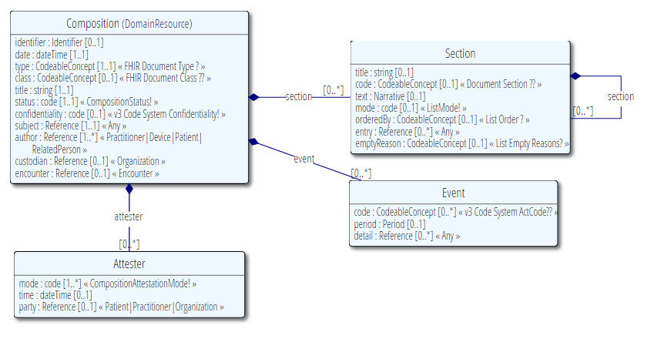
The Composition resource

Slide 124
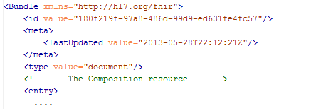
Bundle as “Document”
This Bundle is a Document
Notes:
[RS] Tags are http header “category”s

Slide 125
Communicating documents
You can store your document using
http://server.org/fhir/Composition
Others described in the spec: http://hl7.org/fhir/documents.html
Storage, No disassembly is implied, the document (and signature) stays intact
Search is supported (you search on the Document header – Composition)
Notes:
* But of course, some server could have functions to disassemble documents on reception. Since the contents of documents are resources, each of the contained resources (including the Document header) can be stored using the normal REST interface. But they are no longer the document anymore!

Slide 126
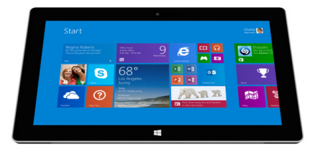
CDA and FHIR
CDA to FHIR Document bridge
FHIR Document processor
FHIR
Repository
FHIR
Documents
V3 CDA Documents
FHIR
REST
Hospital System A
Note: Documents are compositions,
No update semantics
Context?
Wholeness?

Slide 127
messages

Slide 128
Messages Paradigm
FHIR supports 4 interoperability paradigms
REST
Documents
Messages
Services

Slide 129
Messages – are Bundles
<Bundle>
<entry>
<MessageHeader />
</entry>
<entry>
<Observation />
</entry>
<entry>
<Patient />
</entry>
<entry>
<Device />
</entry>
</Bundle>
MessageHeader Resource
source
destination
event
Observation Resource
Device Resource
Patient Resource
Notes:
A Message is similar, refers (amongst others) to its author, and contains information about the source, destination and the event that triggered it.
A message contains 1 “data” resource, which is the root of the payload of the message. This is just a normal resource, which in its turn can refer to other related resources.

Slide 130
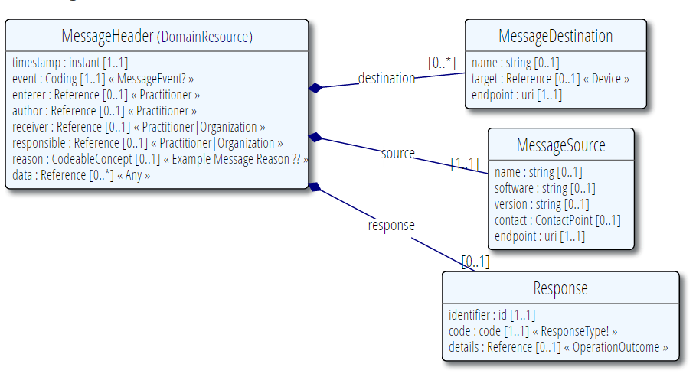
MessageHeader Resource

Slide 131
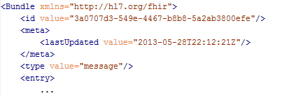
Bundle as “Message”
This Bundle is a Message

Slide 132
Sending messages
Again, REST not necessary, but…
There is an explicit REST operation:
[base]/$process-message
No storage implied. Might be a router, converted to v2, etc. etc.
The server can process them based on the event code and return the response as another message (again a bundle).
http://hl7.org/fhir/messaging.html
Notes:
* It’s the same drop-off point as for documents!

Slide 133
V2 and FHIR
V2 to FHIR bridge
FHIR Message processor
FHIR
Repository
FHIR
Messages
V2 Messages
FHIR
REST
Hospital System
Note: Messages are events,
REST exposes a “repository”
Model of data…

Slide 134
operations

Slide 135
Services Paradigm
FHIR supports 4 interoperability paradigms
REST
Documents
Messages
Services

Slide 136
FHIR Operations
When more complex logic is required than simple CRUD
Midway between REST & SOAP
Some definitions already in the spec. Examples:
Get all data for a patient
Expand/filter terminology
Can define custom operations
OperationDefinition; usually found in an Implementation Guide
Still using FHIR resources
Parameters resource to define inputs and outputs

Slide 137
Operations demo
View Operations Framework in Spec
http://hl7.org/fhir/operations.html
For instance,
$validate
$expand
$everything
Example:
http://fhirtest.uhn.ca/baseDstu3/ValueSet/condition-code/$expand?filter=asthma

Slide 138
SOA
Using FHIR resources with SOA patterns
More complex environments
http://hl7.org/fhir/services.html

Slide 139
Profiles and validation
Short introduction to
Notes:
12:50-13:00

Slide 140
Profiling
The base resource types are not intended to necessarily be used as-is
Many different contexts in healthcare
Specific implementations / Use Cases need to:
Extend resources
Constrain resources
Specify code sets / terminologies
Specify resources used
Multiple supporting artifacts in FHIR
‘Conformance’ resources
FHIR is a platform specification
Profiles adapt it to specific purposes
Doesn’t change wire format
Discoverability / Manage expectations
Profiling increasingly important
Allows clinicians to express requirements
Tooling supports Clinicians and Analysts involvement
Whole spec build on profiling infrastructure
Notes:
Eat your own dog food

Slide 141
Claiming conformance
Profiles are like a template
Servers indicate what profiles they support
Clients can interrogate servers
CapabilityStatement resource lists supported profiles
Resource instances can ‘claim conformance’ to 1 or more profiles
Libraries developed to test this
Can be conformant without claiming
Profiles restrictions
Can define additional constraints to an element
Cannot alter or remove existing constraints

Slide 142
Extensions
Only most common elements in base resource
Keeps the resources small
(Adding everything was the problem with version 3)
Extensions allow other elements to be defined
Same capabilities as core elements
Including resource references and terminology bindings
Can extend properties and data types as well as the resource
Extensions are normal
Expect all real implementations to use extensions
‘normal’ and modifierExtensions
Normal extensions can be ignored by a recipient
Unknown modifierExtensions cannot be ignored

Slide 143
Quick look at extensions
Metadata
Resource
Narrative
Elements
Extensions
Extensions
Notes:
[RS think these notes are copied from slide 20]
Only the Resources are user-definable, other types are “built-in”
Derived primitives are patterns -> validation consists of regexp matching
Constrained types are defined using invariants (OCL, Xpath, prose) -> validation using schematron, code
Narrative and Extension are both ONLY used in Resources
Resources can use both (derived) primitives and composite datatypes in its definitions
Infrastructural types need special handling, not general-purpose types

Slide 144
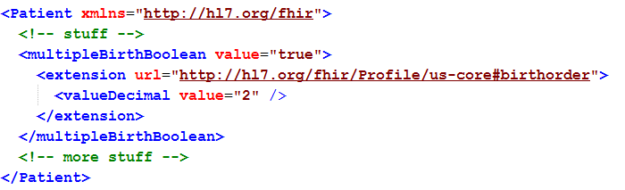
Extending a multiple birth
Key = location of formal definition
Value = value according to definition
Notes:
Really any FHIR element (Resource, Datatype, Primitive) can be extended. Just nest an <extension> element under the thing you want to extend
You should be able to go to the formal definition endpoint and get the definition of the extension.
Note: birth order is already provided for in FHIR through the multipleBirthInteger

Slide 145
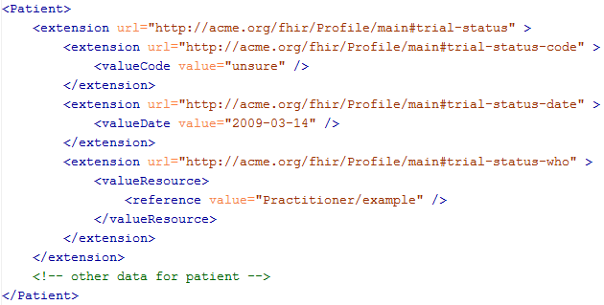
Complex extensions

Slide 146
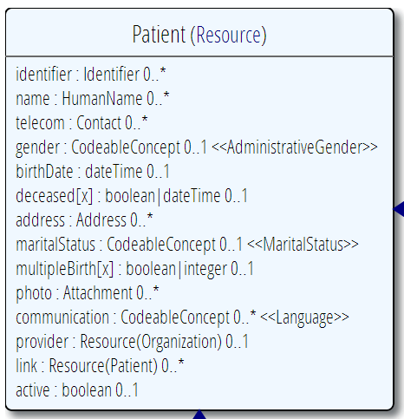
Profiling a resource
Specify that the identifier uses the NHI – and is required
Limit names to just 1 (instead of 0..*)
Limit maritalStatus to different set of codes (ValueSet)
Multiple Birth indicator only boolean
Indicate photo not supported
Add an extension to support “Ethnicity”
Note: hardly any mandatory elements in the core spec!

Slide 147
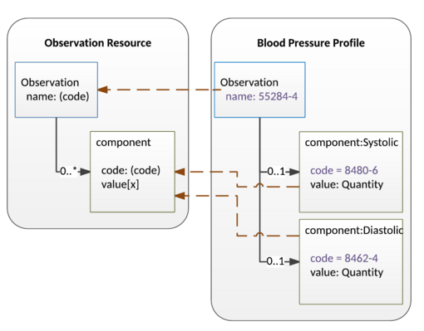
Slicing
Specifies repeating elements
Example: Blood Pressure (Observation.component)
Composition (document sections)
Constrains data types
Example: MedicationDispense.medication

Slide 148
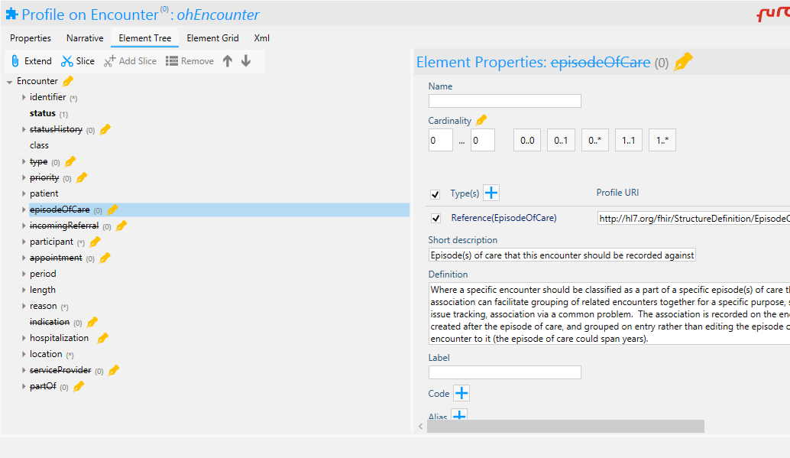
Forge

Slide 149
‘Conformance’ resources
StructureDefinition
The resource that ‘defines’ a resource
core and ‘profiled’
also used for extensions
describes binding to ValueSets
ValueSet
Options for coded elements
NamingSystem
Defines system

Slide 150
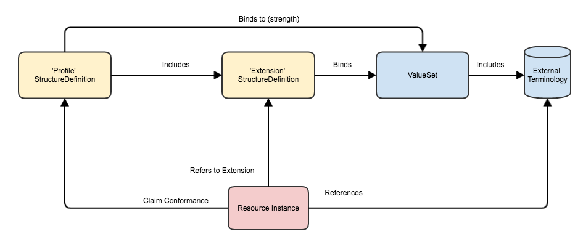
References
URI vs URL
Canonical URL

Slide 151
A profiled resource Instance
{
"resourceType": "AllergyIntolerance",
"meta": {
"profile": [
"http://fhir.hl7.org.nz/stu3/StructureDefinition/ohAllergyIntolerance"
]
},
"extension": [
{
"url": http://fhir.hl7.org.nz/dstu3/StructureDefinition/al-certainty”,
"valueCodeableConcept": {
"text": "really sure"
}
}
],
"patient": {
"reference": "Patient/14317",
"display": "Eve E. Everywoman "
}
}

Slide 152
Validating a claim
It’s only a claim…
Tooling (java) can check/confirm
One resource can be conformant to multiple profiles
For design, use $validate operation
http://hl7.org/fhir/resource-operations.html#validate
Or use XML schema / schematron
Or java validator

Slide 153
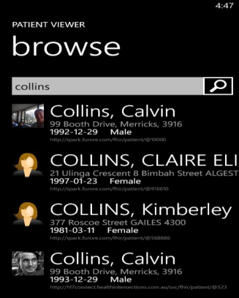
(Distributed) validation
App’s server
Profile X
Profile Y
Store &
Validate
Country validation server
Profile X
Validate Y
Profile Y
Download & Validate
Profile Y
Notes:
A server might defer validation to another server (because it doesn’t know the profile)
A server may fetch the “unknown” profile and validate it itself
There may be several servers sharing the work

Slide 154
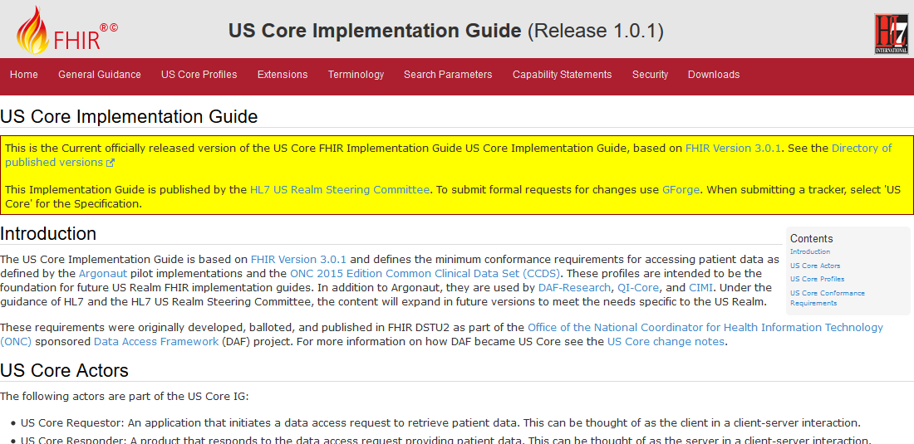
Implementation Guide: US Core
http://hl7.org/fhir/us/core
Notes:
Show in spec

Slide 155
Viewing Profiles: clinFHIR
Select Profile
Look at structure
Build resource
http://clinfhir.com

Slide 156
Moving on…
Notes:
13:00-13:20

Slide 157
FHIR R4
Some Normative content
Updated and new resources
Implementation Guides
Workflow
Reference links:
http://hl7.org/fhir/R4 or http://hl7.org/fhir
https://onfhir.hl7.org

Slide 158
Extending FHIR
FHIRPath
http://hl7.org/fhirpath
FHIR Mapping Language
http://hl7.org/fhir/mapping-language.html
CDS Hooks
https://cds-hooks.org
SMART on FHIR
https://smarthealthit.org

Slide 159
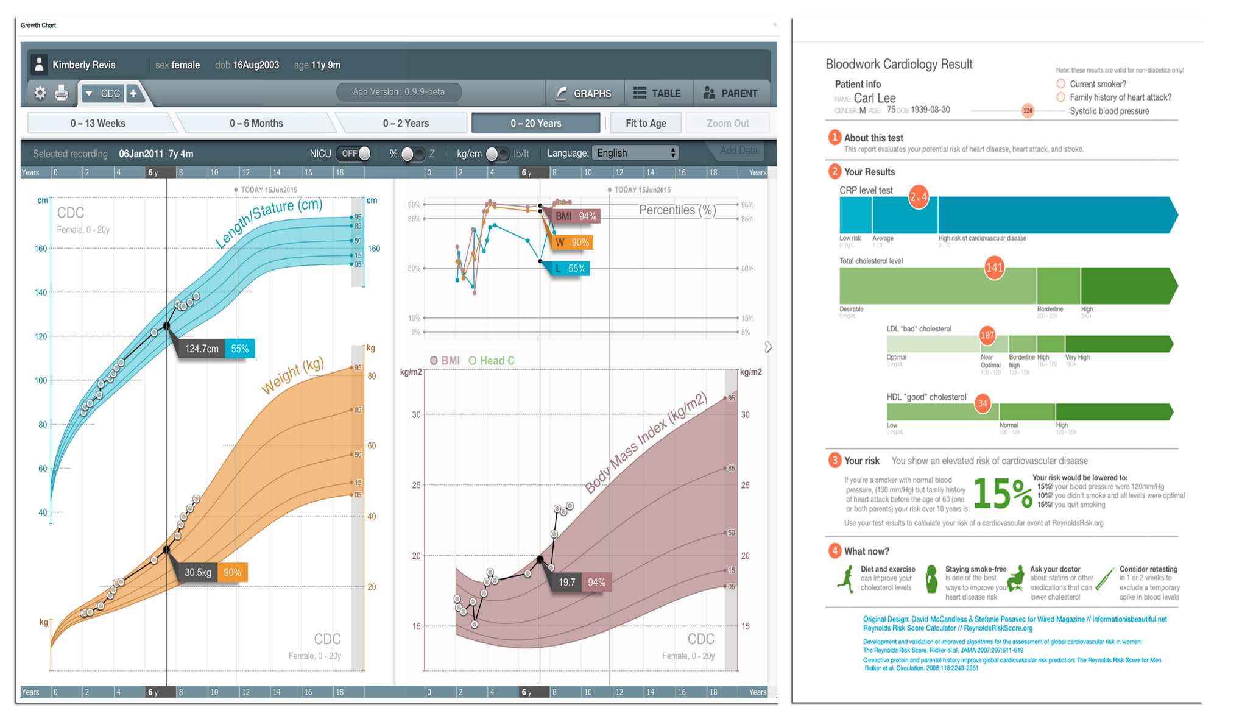
SMART on FHIR Example

Slide 160
exposing a fhir service
FHIR in practice
Notes:
Time: 2:35:00-2:55:00 (20 minutes)

Slide 161
Process for Organizations
Design / Gap analysis between internal data stores & FHIR
Outcome = resources, extensions & constraints
Find / build extensions & publish
Which registries?
URI vs URL
Build & publish profile
Update CapabilityStatement resource
Including operations
Use clinFHIR for samples

Slide 162
Architectures
v3
App
v2
FHIR
PHR
FHIR
Broker
Comm.
Interface
FHIR
DB
Notes:
You’re a message broker routing and translating between v2, v3 and FHIR
Your app interfaces with a PHR using FHIR natively
Your application can communicate using FHIR, but your software uses a proprietary RDBMS
[Use FHIR as the common language for a Vendor Neutral Archive – this is not pictured here but is ] [RS]
…Or a combination….
You might see data as a nested structure of XML, a series of tables with keys, class-diagrams….

Slide 163
Repository Model – FHIR Interfaces
HIS
LIMS
PACS
SystemX
Gateway
FHIR Mapping Interface Layer
FHIR
FHIR
FHIR
FHIR
FHIR
Vendor Neutral Repository

Slide 164
Some thoughts
Study the spec
Much more than the resource list
Use existing libraries
Expose a CapabilityStatement resource
Create profiles
Utilize testing services
http://touchstone.com
http://projectcrucible.org
Come to a Connectathon
Join the community

Slide 165
Adding profile claims to resources
Technically easy
Meta.profile[]
Can the server decide?
Or must resource claim – should server validate
If server, then at Read or Write time?
What to do with resources containing data we don’t store
What about non-conformant data?
Example: we have observation codes in a different terminology
?Client responsibility

Slide 166



Implementer’s Safety Checklist
http://hl7.org/fhir/safety.html#7.10.1

Slide 167
Specification to Development
What’s the Interface?
Implementation guide
CapabilityStatement resource
Profiles
Extension Definitions
ValueSets
Other ‘conformance’ resources

Slide 168
Security
FHIR is not a security standard
Leverages existing standards (OAuth2, SSL, TLS, …)
New and existing standards use FHIR that may impose security
CDS Hooks and SMART (OAuth2)
IHE on FHIR
Security tags
Specialized resources
AuditEvent, Consent, Provenance
http://hl7.org/fhir/security.html

Slide 169
The end is near…
Notes:
Time: 10:00-35:00 (25 minutes)

Slide 170
R4 and beyond
Fourth release (with mixed STU and Normative content) is now complete
FHIR is now currently published as R4 (release version 4)
Provide a more stable platform for implementers while still allowing non-backward-compatible change for Normative content if implementation experience dictates
Release cycle is roughly every 1.5 - 2 years to make fixes, introduce new resources and advance existing resource maturity
First release with normative content in the specification
*Lots* of implementation experience went into this version before committing to backward compatibility

Slide 171
More information/help
http://www.hl7.org/implement/standards/fhir/
http://www.fhir.org/
https://chat.fhir.org/
http://wiki.hl7.org/index.php?title=FHIR
http://www.healthintersections.com.au/
https://fhirblog.com/
https://thefhirplace.com/

Slide 172

Next Steps for you
Read the spec: http://hl7.org/fhir
Try implementing it
Firely Devdays
https://www.fhirdevdays.com
Come to a Connectathon!
Join the community
https://chat.fhir.org
fhir@lists.hl7.org
Twitter #FHIR
StackOverflow: hl7 fhir tag
Blogs & wiki: http://wiki.hl7.org/index.php?title=FHIR

Slide 173
Thank You - QUESTIONS?
Notes:
[RS – added thank you]

